Slide 1
Multi Skill Voice Assistant for
Visually Impaired
Team - Pioneers

Slide 2
Aim
To build a multi skill chatbot for the visually impaired.
Helping them in getting all the information related to trains like trains between stations,seat availability,PNR status and so on.
Also fetching cricket scores of the ongoing matches.
Letting its users book train tickets and other services via IRCTC portal.

Slide 3
Technologies Used
NodeJS
Alexa Skills Kit

Slide 4
APIs
Indian Rail API (requested for access)
Cricbuzz API (requested for access)

Slide 5
UI
Since our project deals with development of a chatbot for visually impaired people having a UI for them isn’t necessary at all.
It can be added in future if we plan to extend our product for other users as well.
Alexa Skills are now supported in multimodal devices and the UI can be designed using Alexa Presentation Language(APL) , a small library developed by Alexa team for creating UIs for Alexa screen enabled devices.

Slide 6
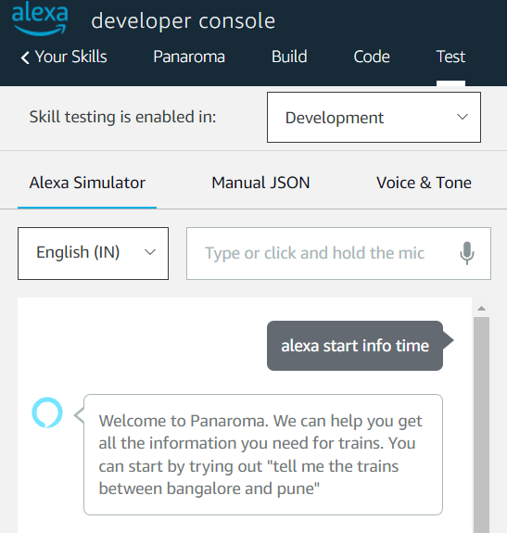
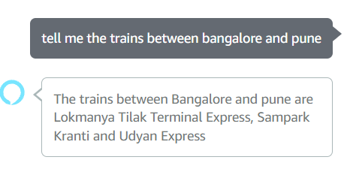
Demo Screenshots

Slide 7
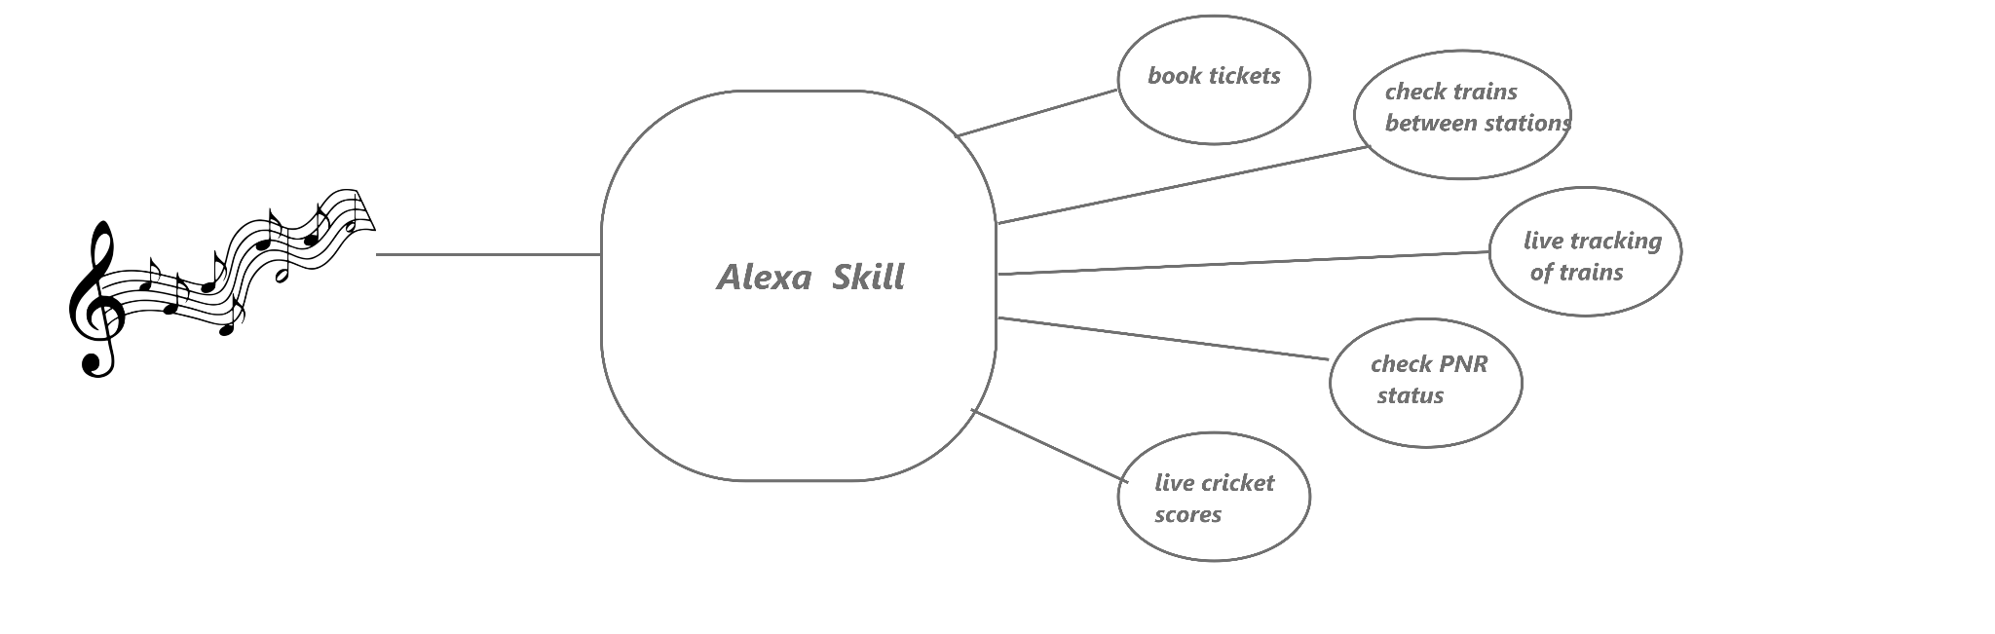
Architecture Of The Product

Slide 8
Final Outcome And Results
Tasks Done:
The alexa skill is able to provide the information of trains running between two different stations.
The logic for fetching the information about any train like running status,availability of seats,etc.
To Dos:
Integrate the indian rails api with the skill.
Integrating the cricbuzz api with the skill.
Refining the conversation flow to make the skill more robust.

Slide 9
Upcoming
Help user in booking tickets.
Acting as a channel between users and IRCTC for booking hotels,ordering food and many more.
Enabling the payment gateway for the ticket gateways.
Exploring possible ways of authentication for making payments through the skill.
Check IPL/Cricket scores.

